Slide 2


May 7th, 2022

Slide 3
Distributed cloud with Azure Arc
Phi Huynh

Slide 4
Agenda
What is distributed cloud
Azure Arc introduction
Azure Arc for infrastructure
Azure Arc for application
Question

Slide 5
” Distributed cloud is the distribution of public cloud services to different physical locations, while the operation, governance, updates and evolution of the services are the responsibility of the originating public cloud

Slide 6



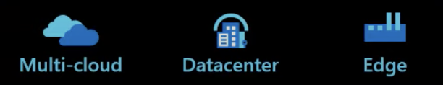
Microsoft Azure
Single control plane with Azure Arc
Azure enabled infrastructure
Azure enabled services
Connect and operate hybrid resources as native Azure resources
Deploy and run Azure services outside Azure while still operating it from Azure

Slide 7

Single pane of glass
Organize & Govern | Secure | Protect
Monitor | Automate | DevOps
Azure Arc
Any apps | Any K8S | Any infrastructure

Slide 8
How does Azure Arc help?
Use familiar tools and services
Flexibility and convenience
Deploy apps consistently to all K8S clusters
Velocity and stability
Automated cluster, app security and governance
Single pane of glass management

Slide 9





Azure application services Run your app anywhere
Preview
App Service
Function
Logic Apps
API
management
Event grid
Azure Arc
On-premise | AWS | GCP

Slide 10




Velocity + stability Single pane of control
App
Developer
Existing tools
and practices
Azure Arc
+ GitOps
Global
reach

Slide 11


Application update at a branch location
Store location with Azure Arc
1
2
3
4
5
Arc Function
App
Developer
Use existing tools
and practices
Azure Arc Enabled
App Service
Azure Arc
Enabled K8S
Azure Arc
Enabled SQL
Arc Function

Slide 12




Runs your application your way on any platform
Azure Arc-enabled application services
Azure Arc-enabled data services
Azure Arc-enabled ML services
1
2
App
Developer
Use existing tools
and practices
Azure Arc-enabled infrastructure
Azure Arc
On-premises | AWS | GCP

Slide 13




An AI healthcare system
Azure: Corporate office
Blob storage
App Service
AKS
Cosmos DB
Service Bus
Store location with Azure Arc
Mobile
Arc Function
Azure Arc Enabled
App Service
Azure Arc
Enabled K8S
Azure Arc
Enabled SQL
Arc Function

Slide 14
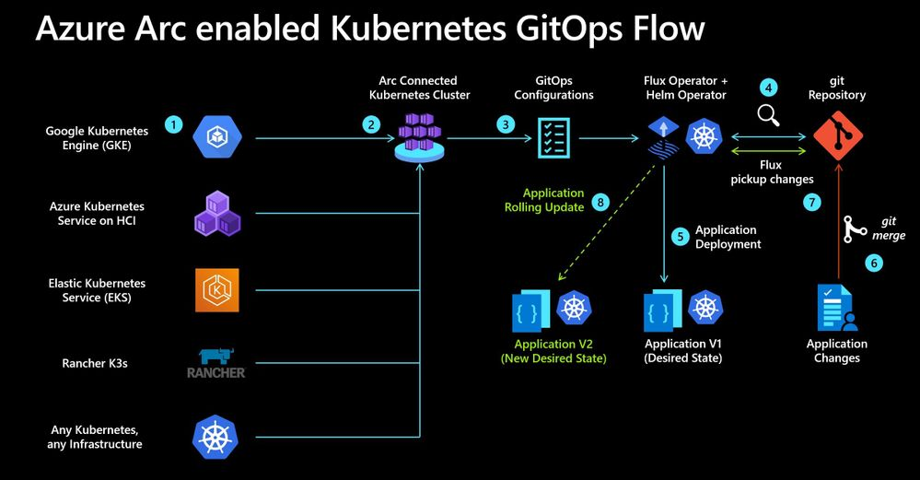

Slide 15


Question & answer
https://www.facebook.com/devcafevn

Slide 16
Thanks for joining !
https://www.facebook.com/devcafevn

